Slide 1

This resource is designed to complement teaching of the parliamentary legislative process in Queensland.
How to use:
Select the appropriate activity for the level of learning. There are three versions of the flow chart included to cater for different levels of understanding. Instructions (editable) are included in the notes section for each slide.
Delete slides not relevant to learners (including this one), before sharing electronically.
For students attempting the additional activities, hyperlinks to Current Bills and Bills this Parliament can be found on the ‘Additional Materials’ slide.
A modified print version of this activity is available and can be found here.
A printable version of the complete flow chart is available here.
Contents:
Flow Chart 1 Matching activity Instructions, Stage Headings and Stage Descriptions
included
Flow Chart 2 Students write description of stages in own words Instructions and Stage Headings included
Flow Chart 3 Students add stage headings and descriptions Directional arrows and numbered boxes included
Flow Chart 4 Blank flowchart Directional arrows included
Additional Material Links, classroom activities and factsheets related to the parliamentary legislative process.
To access hyperlinks above please view in Presentation mode.

Slide 2
The Queensland Parliament and the Legislative Process
A Bill is a proposal for a new law or a proposal to change an existing law presented before Parliament for debate.
There are two types of Bills:
Government Bills which form the majority of the State's legislation and relate to public policy, having general application over the entire State, e.g. the Police Service Administration Bill.
Private Members' Bills are bills introduced by an individual Member of Parliament instead of the Government, e.g. the Criminal Code (Palliative Care) Amendment Bill, which was introduced by Mr Peter Wellington MP, an Independent Member.
Form of a Bill
A Bill is identified by a Long Title which, in brief terms, describes the purposes of the legislation, e.g. a Bill for an Act to extend the legislative powers of the States in and in relation to coastal waters. For convenience, the Long Title is compressed into a Short Title, allowing easier recognition of the later Act, e.g. Coastal Waters (State Powers) Act 1980.
Origin of a Bill
Usually a Bill is the result of a Government's perceived policy needs as outlined during a general election. However, a Government may introduce legislation based on the requirements of other sources such as Government departments, outside interest groups or required amendments to current legislation.
Approval of Government Bills
Before a draft Bill is introduced into the Parliament, it undergoes an interrelated process involving approval, drafting, coordination and advice. Firstly, the original policy is formatted by the department and is then approved in substance by Cabinet. Where necessary, cross-departmental coordination is held with interest groups. The Office of the Queensland Parliamentary Counsel is responsible for drafting into Bill form, with the final approval provided by Cabinet and the relevant political party/ies.

Slide 3
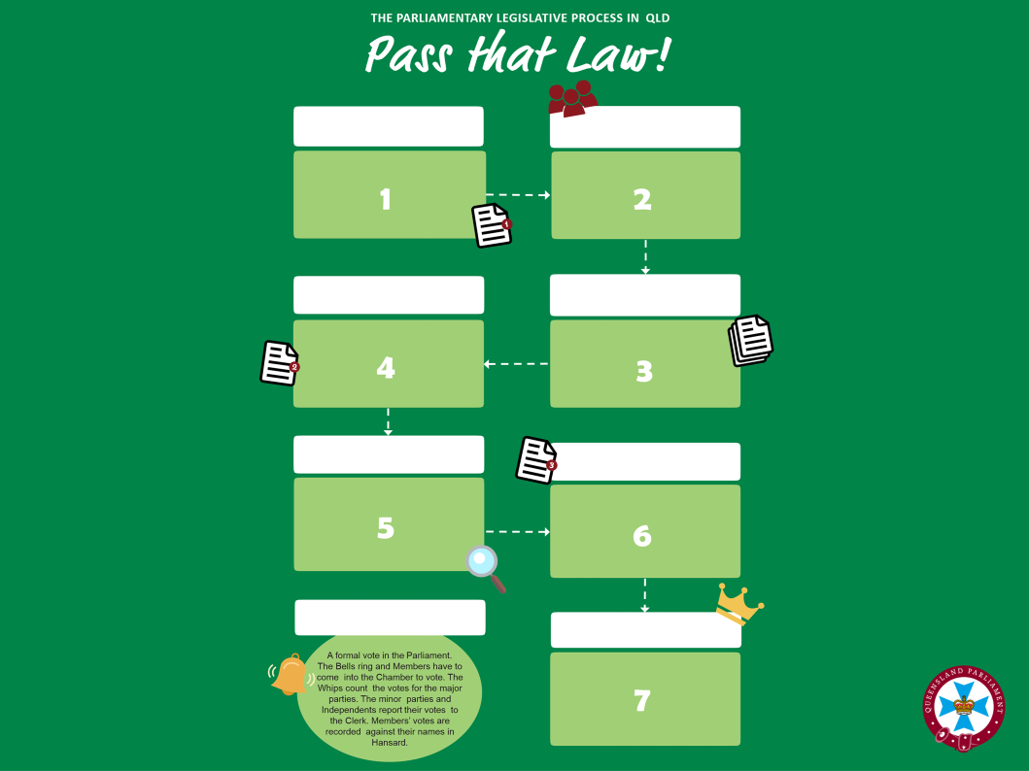


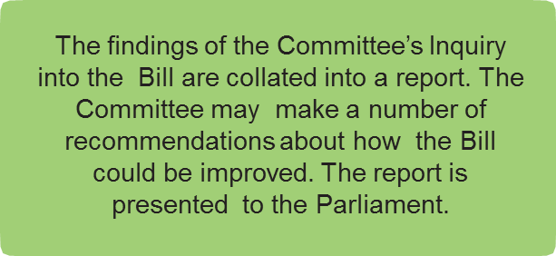


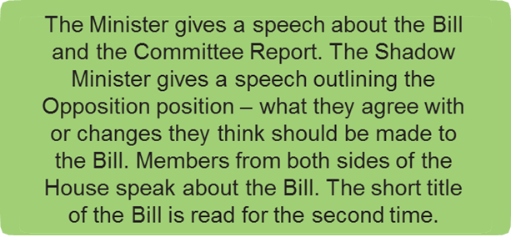
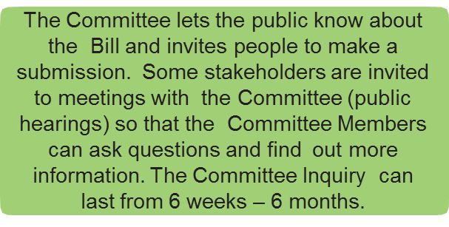


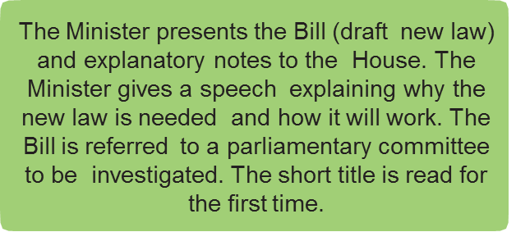
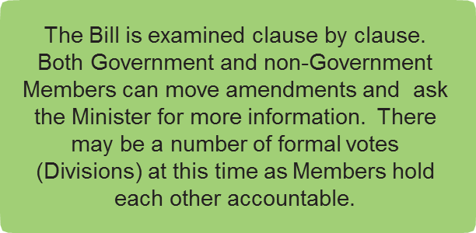

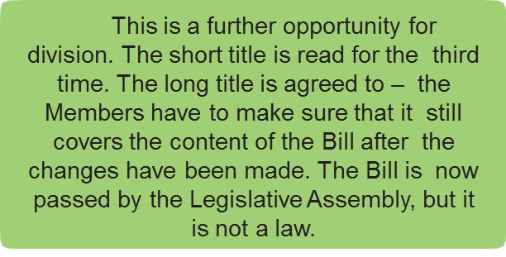

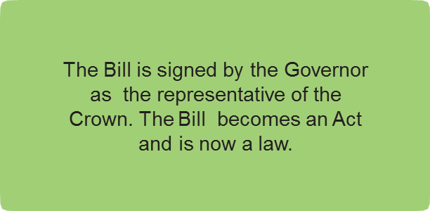
Notes:
Instructions:
Use the white text boxes provided to place each state in order on the flow chart.
Match the green description text boxes to the correct heading.
Additional Activities
Examine Current Bills
Choose a current act or bill – see links on last slide.
Add text boxes to your diagram with the dates each stage was reached for that bill or act.
Investigate how ideas for new laws or changes to existing laws become bills.
Create an infographic that uses images and limited text to outline the legislative process in Queensland.
Discuss the steps in the process
Legal studies
Compare the legislative processes at State and Federal levels.
Explain implications of the unicameral parliament in Queensland using your completed comparison in your response.
Describe how this process is different if a bill is determined Urgent.

Slide 4
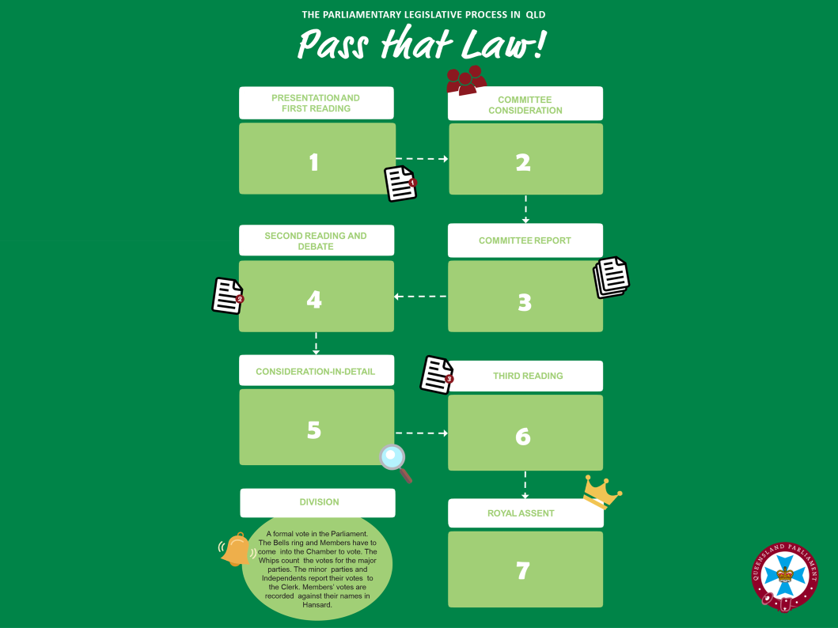
Notes:
Instructions:
Use the white text boxes provided to place each state in order on the flow chart.
Match the green description text boxes to the correct heading.
Additional Activities
Examine Current Bills
Choose a current act or bill – see links on last slide.
Add text boxes to your diagram with the dates each stage was reached for that bill or act.
Investigate how ideas for new laws or changes to existing laws become bills.
Create an infographic that uses images and limited text to outline the legislative process in Queensland.
Discuss the steps in the process
Legal studies
Compare the legislative processes at State and Federal levels.
Explain implications of the unicameral parliament in Queensland using your completed comparison in your response.
Describe how this process is different if a bill is determined Urgent.

Slide 5

Notes:
Instructions:
Use the white text boxes provided to place each state in order on the flow chart.
Match the green description text boxes to the correct heading.
Additional Activities
Examine Current Bills
Choose a current act or bill – see links on last slide.
Add text boxes to your diagram with the dates each stage was reached for that bill or act.
Investigate how ideas for new laws or changes to existing laws become bills.
Create an infographic that uses images and limited text to outline the legislative process in Queensland.
Discuss the steps in the process
Legal studies
Compare the legislative processes at State and Federal levels.
Explain implications of the unicameral parliament in Queensland using your completed comparison in your response.
Describe how this process is different if a bill is determined Urgent.

Slide 6
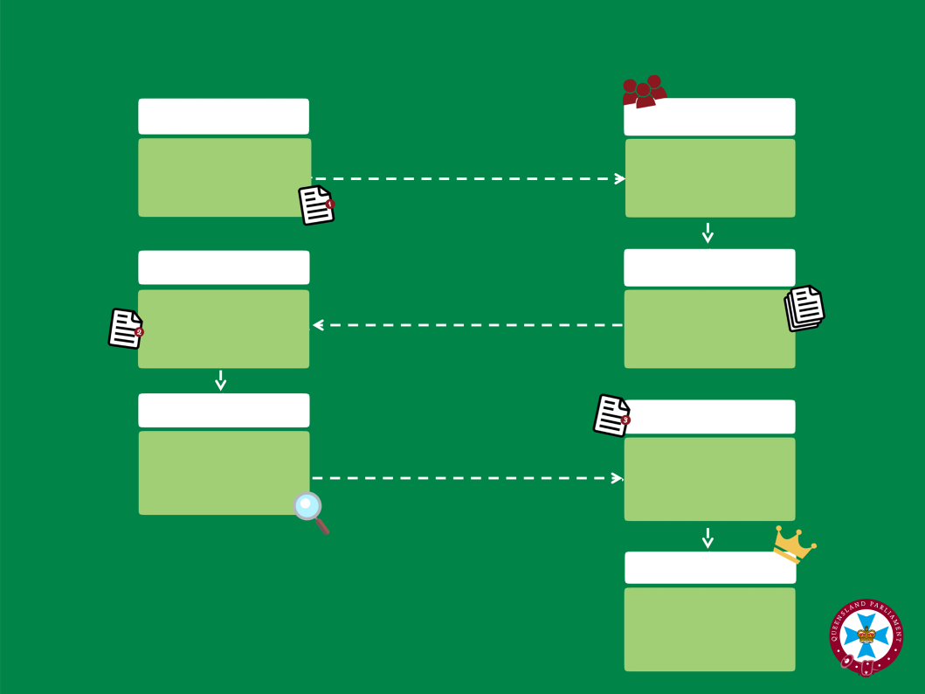
Notes:
Blank for teacher instruction

Slide 7
Additional Material
Classroom activities based on legislation/legislative process
Bills currently before the House
Bills this Parliament
Factsheets
Legislation Process FAQ
https://www.parliament.qld.gov.au/documents/explore/education/factsheets/Factsheet_3.5_LegislativeProcessFAQ.pdf
The Legislative Process - The Making of a Law (simplified)
https://www.parliament.qld.gov.au/documents/explore/education/factsheets/Factsheet_3.7_MakingOfALaw.pdfOverview of the
The Legislative Process - The Making of an Act (complex)
https://www.parliament.qld.gov.au/documents/explore/education/factsheets/Factsheet_3.6_MakingOfAnAct.pdf
Parliamentary Reform and Modernisation Initiatives
https://www.parliament.qld.gov.au/documents/explore/education/factsheets/Factsheet_3.22_OverviewOfParliamentReformAndModernisation.pdf
Parliamentary Committees
https://www.parliament.qld.gov.au/documents/explore/education/factsheets/Factsheet_3.9_ParliamentaryCommittees.pdf
To access hyperlinks above please view in Presentation mode.

